Slide 1
Learnify
-An e-learning website

Slide 2
Table of Content
01
Introduction
02
Literature Survey
03
Objectives
04
Problem Statement

Slide 3
Table of Content
05
Methodology
06
Results
07
Future Scope
08
References

Slide 4
Introduction
The e-learning website is a platform that provides a virtual learning environment for users to access a variety of educational materials and courses. It utilizes technology to facilitate the learning process, enabling users to learn at their own pace and from anywhere in the world. E-learning websites are online platforms that provides educational content and courses to learners through the internet. This website is useful for learners as it offers a flexible and convenient way to learn new skills or gain knowledge.
Additionally, the e-learning website provides personalized learning experiences by offering tailored recommendations based on users' learning preferences and progress. This personalized approach ensures that users receive content and courses that align with their individual needs and goals. The platform is designed with a user-friendly interface that is intuitive and easy to navigate. Users can easily track their progress, earn certificates of completion, and receive feedback on their performance. These features help users stay motivated and monitor their achievements throughout their learning journey.
Overall, the e-learning website serves as a valuable resource for individuals looking to acquire new skills and knowledge, further their education, or improve their career prospects. Its convenient accessibility, interactive features, and personalized learning approach make it a valuable tool for learners of all backgrounds and levels of expertise.

Slide 5
Literature Survey
1990
2000
2010
2020
With the advent of internet e-learning emerged as a concept and early e-learning websites started to appear.
As e-learning became popular, literature review started to become more common in this field.
The proliferation of e-learning websites and online education platforms led to an explosion of literature on the subject.
The COVID pandemic led to a massive shift toward online learning, which in turn spurred a surge of interest in literature reviews on e-learning.

Slide 6
Existing Solution:
There are many existing solutions in e-learning websites that have been developed to enhance the learning experience for students. Here are some examples:
An LMS is a software application that provides a platform for delivering and managing online learning. LMSs offer a range of features such as course management, assessments, and tracking of student progress.
Many e-learning websites offer mobile apps that allow students to access course materials and complete assignments on their mobile devices.
Many e-learning websites offer mobile apps that allow students to access course materials and complete assignments on their mobile devices. This makes learning more flexible and accessible for students who are on the go.
Proposed System:
AI tools can be used to provide personalized learning experiences. For example, an AI-powered ChatBot can provide real-time support to students, while an adaptive learning algorithm can adjust course materials based on each student's progress.
Virtual and augmented reality technologies can provide an immersive and engaging learning experiences that help students retain information.
E-learning websites can incorporate social features such as discussion forums, group projects, and peer review assignments to foster a collaborative learning environment.
Online learning platforms can incorporate video conferencing solutions that allow instructors and students to interact in real-time.

Slide 7
Objectives
The objective of an e-learning website is to provide online education and training to individuals who can access it anytime and anywhere with an internet connection. Some specific objectives of our website ‘Learnify’ may include:
Learnify aim to provide courses and educational materials that are designed to be engaging, interactive, and informative.
Learnify allow learners to take control of their learning experience and learn at their own pace. This helps learners to learn more effectively and retain the knowledge they gain.
It aim to measure learning effectiveness by using data analytics and assessment tools to evaluate learners' progress and determine the effectiveness of the educational content and instructional strategies.
Learnify helps learners to stay motivated and on track towards achieving their learning goals.
This website aim to democratize education by providing equal access to educational resources and opportunities for all learners.
This website aim to facilitate self-directed learning by providing learners with the resources and tools they need to take control of their own learning journey.

Slide 8
Problem Statement
Here are some common problems that may arise in e-learning websites:
Technical issues such as internet connectivity problems, server downtime, and hardware issues can prevent students from accessing the platform and completing their coursework.
Online learning can be isolating and students may struggle with staying engaged and motivated. This can result in lower completion rates, lower student satisfaction, and ultimately lower learning outcomes.
It may not provide enough opportunities for students to interact with their peers and instructors, which can lead to a lack of social support and sense of community.
E-learning platforms may not provide personalized learning experiences, which can lead to students feeling disconnected from the course and disengaged.
It may not provide enough resources to support students, such as access to textbooks, reference materials, or academic support services. This can impact students' ability to learn and succeed in the course.

Slide 9
Methodology
The

Slide 10
Results

Slide 11
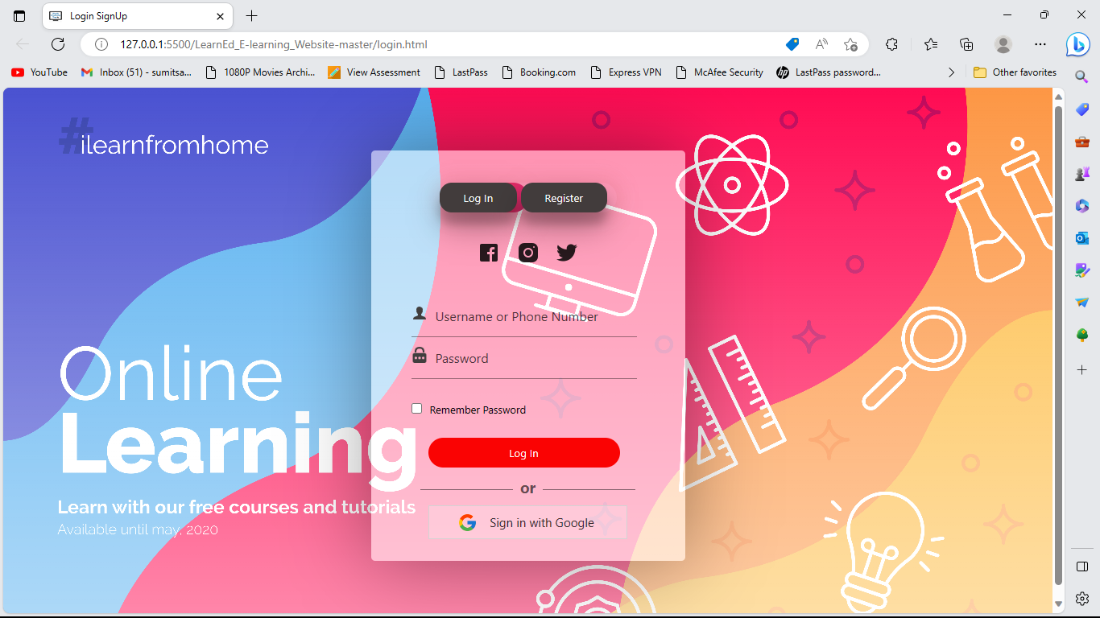
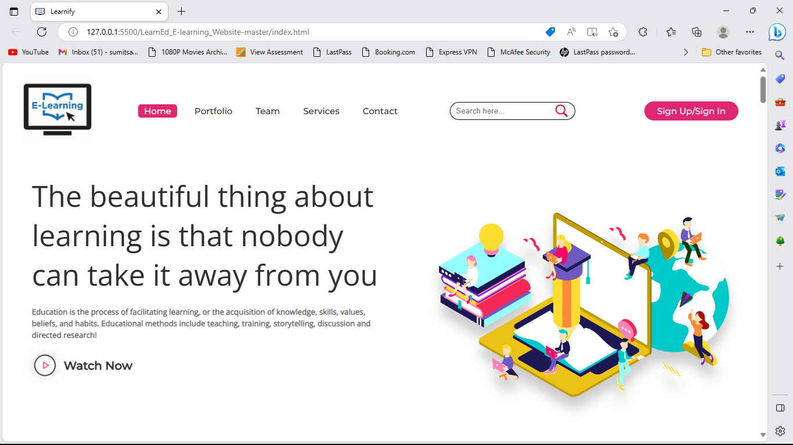
Future Scope
The

Slide 12
References
Here are

Slide 13
THANK YOU

